Slide 1
Physiology of Pain
Key Neurophysiological Concepts
Department of Physiology

Slide 2

INTRODUCTON
AND ESSENTIAL
DEFINITIONS

Slide 3
What Is Pain
International Association for the Study Pain (ISAP) Definitions
Pain is an unpleasant sensory and emotional experience associated with actual or potential tissue damage, or described in terms of such damage

Slide 4
“Benefits” of Pain
Alerts about a problem in the body Protects the body from further injury Withdrawal reflexes Diabetics, peripheral neuropathy and increased risk of foot ulcers, gangrene and amputations Aids healing Resting injured parts of the body Inability to feel pain may lead to multiple traumas and injuries

Slide 5
Nociception
Nociceptors: are specialized, neurologic receptor that is capable of differentiating between innocuous and noxious stimuli
They are the endings of small unmyelinated (C fibers) and lightly myelinated (A-delta) afferent neurons
Nociceptive neuron – A central or peripheral neuron of the somatosensory nervous system that is capable of encoding noxious stimuli = A-delta and C neurons.
Nociception - The detection of tissue damage by specialized transducers connected to A-delta and C-fibers

Slide 6
Paresthesia and Hypoesthesia
Paresthesia = an abnormal sensation, whether spontaneous or induced / evoked
May or may not be painful
Dysesthesia = painful paresthesia. – Examples
feeling of “pins and needles” in a limb when a nerve is compressed
“burning feet” felt in alcoholic peripheral neuropathy
Hypoesthesia = decreased sensitivity to stimulation. / area of relative numbness
Causes = nerve injury, infiltration with local anesthetic, etc.

Slide 7
Pain Threshold
The minimal stimulus required to produce a sensation of pain on 50% of occasion
The point at which a stimulus is perceived as pain
For example, most subjects will define a thermal stimulus as painful when it reaches about 50 C.
Mediated by A-delta fibres
Reproducible
Pain threshold show minimal variation among healthy people or in the same person over time
Threshold tends to increase with aging

Slide 8
Pain Tolerance
The maximum intensity of a pain-producing stimulus that a subject is willing to accept in a given situation.
The intensity of pain that an individual will endure before initiation overt pain responses.
mediated by C fibres
Clinically is of much more importance than pain threshold
Factors affecting pain tolerance
Individual differences - tolerance varies among individuals and in the same person over time
Drugs: tolerance increased by alcohol consumption, hypnosis
Activities: tolerance may be increased by distracting activities,
Faith or strong belief may increase pain tolerance – Others

Slide 9
Allodynia and Hyperalgesia
Allodynia is pain due to a stimulus that does not normally provoke pain.
The stimulus leads to an unexpectedly painful response.
Types
Thermal allodynia = an innocuous warm or cold breeze may be perceived as painful
Mechanical allodynia = very light touch (e.g. clothes rubbing against the skin) may be painful
Common in many neuropathic pain conditions

Slide 10
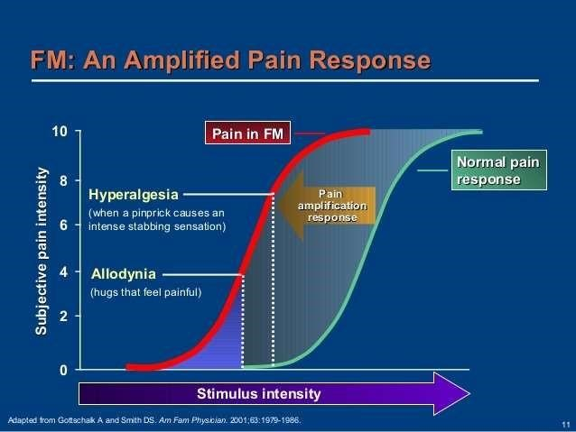
Allodynia and Hyperalgesia

Slide 11
Allodynia and Hyperalgesia
Hyperalgesia - an increased response to a normally painful stimulus Allodynia - a painful response to a normally non-painful stimulus

Slide 12
Analgesia and Anaesthesia
Analgesia
Absence of pain in response to stimulation which would normally be painful.
Analgesia can be produced
Peripherally (at the site of tissue damage, receptor, or nerve)
Centrally (in the spinal cord or brain)
Anesthesia
Reversible loss of many sensory modalities like consciousness, pain, etc.
Specific modalities lost depends on kind of anaesthesia

Slide 13
Classification of Pain

Slide 14
Classification of Pain
Pain may be classified based on etiology, mechanism, duration, location, etc.
Acute Vs. Chronic Pain
Nociceptive Vs. Neuropathic
Primary Vs. Secondary • Somatic Vs. Visceral
Etc

Slide 15
Acute Vs. Chronic Pain
Lasts less than 3 months Onset often sudden | Persist for more than 3 months Often develops insidiously
Sharp, localized; may radiate | Dull, arching, and diffuse
Autonomic responses usually present | Autonomic responses usually absent
Emotional responses – anxiety and restlessness | Emotional response – flat / depression
Cause often known | Cause often unknown
Resolves during the appropriate healing period | Outlasts the usual healing process.

Slide 16
Acute Vs. Chronic Pain
Acute pain may serve as a protective mechanism
– Alerts the individual to a condition that is immediately harmful to the body
Delay or improper treatment of acute pain may lead to chronic pain.

Slide 17
Nociceptive Vs. Neuropathic Pain
Pain pathways are intact • Disease of the pain signaling system
• May serve a biological purpose Central or peripheral malfunction
– e.g. protective function. in the pain signaling pathway
• May be acute (physiologic) Perception of pain in the absence of
or chronic (pathologic) tissue damage
Serve no useful purpose

Slide 18
Primary Vs. Secondary Pain Syndromes
Primary pain syndromes - the pain itself is the disease. – Examples include migraine and cluster headaches
• Secondary pain syndrome – pain is due to an underlying structural cause e.g. tumor or infection. – Example trigeminal neuralgia due to a tumor pressing on the cranial nerve

Slide 19

The Spinal Cord and Pain Pathway

Slide 20
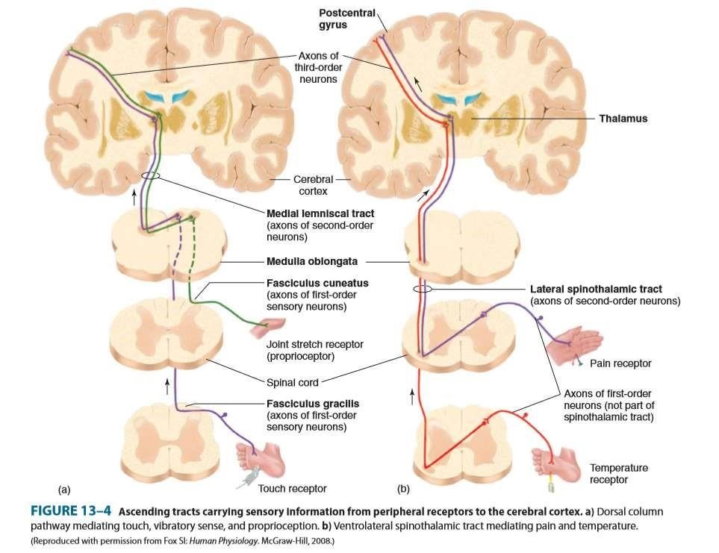

Slide 21
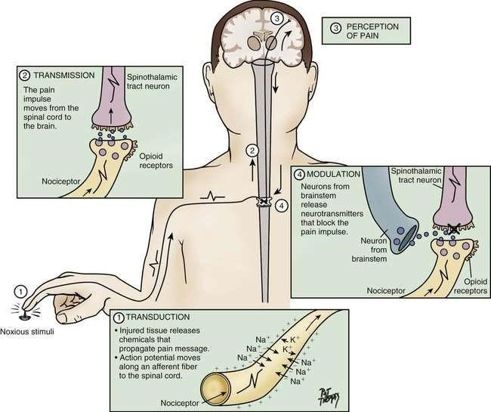

Slide 22
Pain Pathway
Elaborate Steps In The Pain Pathway
Detection of stimuli by nociceptors (nerve terminals).
Transduction:: conversion of physical stimulus into electrical activity by nociceptors.
Transmission: Propagation of electrical activity in the nervous system.
Perception: Subjective interpretation of electrical activity.
Modulation: Modification (enhancement or inhibition) of electrical activity
Peripheral or central

Slide 23
What Causes Pain

Slide 24
What Causes Pain?
Tissue injury
(e.g. mechanical trauma, surgical incision, dissection, burns – friction, chemical, heat, mechanical, etx)

Slide 25
Physiology of Pain
Tissue injury stimulates the release of inflammatory mediators from
Tissues – e.g. prostaglandins, potassium, leukotriene
Cells
Mast cells – e.g. histamine
Platelets - e.g. serotonin
Sympathetic and sensory afferent nerve fibres - e.g. substance P released by primary nerve afferents.
Blood vessels

Slide 26
Chemicals Released By Tissue Damage That Stimulates Nociceptors
.

Slide 27
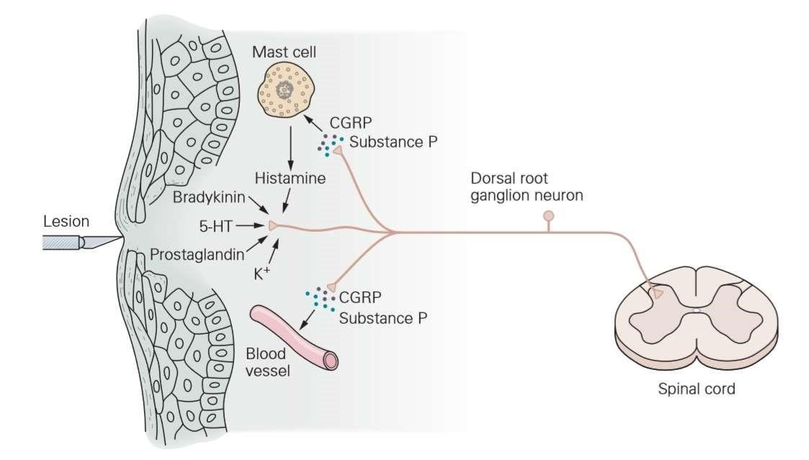

Slide 28
Chemicals Released By Tissue Damage That Stimulates Nociceptors
Chemical | Key Physiological Effect
Prostaglandins, Leukotriene and cytokines | Nociceptor sensitization
Serotonin Kinins: bradykinin (in blood) kallidin (in tissues) | Nociceptor activation

Slide 29
Chemicals
Adenosine and H+ | Hyperalgesia
Histamine |  | Vasodilation, oedema, nociceptor stretch and sensitization Itching

Slide 30
Nerve Problems
Direct nerve injury (i.e., nerve transection (e.g. .surgical damage), stretching, disc prolapse, compression)
Inflammation of the nerves – neuritis
Invasion of nerve - e.g. by cancer
Injury to the structures in the spinal cord, thalamus, or cortical areas that process pain information,
Abnormal activity in the nerve circuits that is perceived as pain, e.g., phantom pain with cortical reorganization.

Slide 31
Nociception

Slide 32
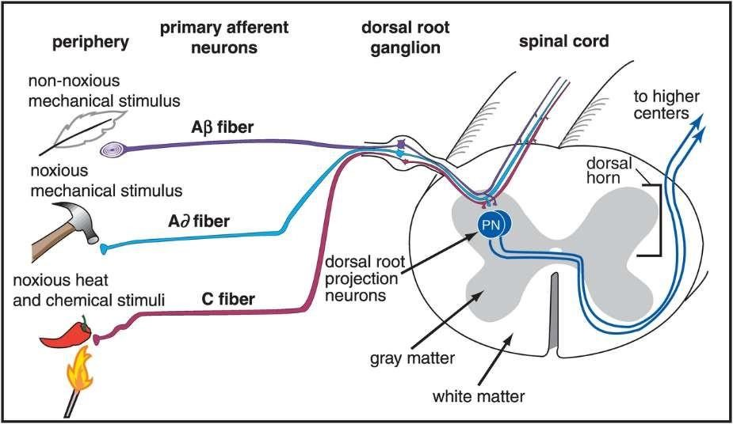
1. Detection (Nociception)

Slide 33
Detection (Nociception)
Nociception - the detection of tissue damage by specialized transducers connected to A-delta and C-fibers
Nociceptors: - specialized / unspecialized neurologic receptor that capable of differentiating between innocuous and noxious stimuli
They are the endings of small unmyelinated (C fibers) and lightly myelinated (A-delta) afferent neurons
Location of nociceptors = skin (epidermis) subcutaneous tissue, muscles, tendons, and visceral organs
Greatest density in skin (epidermis)
Kinds of stimulants that stimulate nociceptors = mechanical, thermal, chemical, electrical, etc.

Slide 34
Types of Nociceptors
Mechanical nociceptors – responds to mechanical stimuli
e.g. strong pressure
Thermal nociceptors- responds to extremes of temperature (burning heat or cold)
Chemical nociceptors- response to chemicals (see earlier slide)
Polymodal nociceptors- mechanical , thermal and chemical

Slide 35
Types of Nociception
First or Epicritic Pain
Perception of a sharp, pricking pain at the moment of injury – Localized to a well-defined part of body surface
High threshold mechano or thermal receptors respond to thermal and noxious mechanical stimuli
Mediated mainly by Aδ fibers
Second or Prothopathic Pain
a dull aching pain lasts long after the termination of the stimulus
often diffuse (not clearly localized)
polymodal nociceptors respond to 3 major modalities of tissue damaging stimuli (chemical, thermal and mechanical) – Mainly by C fibres

Slide 36
Transduction

Slide 37
Transduction
Transduction = conversion of stimuli (thermal, electrical, chemical, etc.) into nerve impulses

Slide 38
Transmission

Slide 39
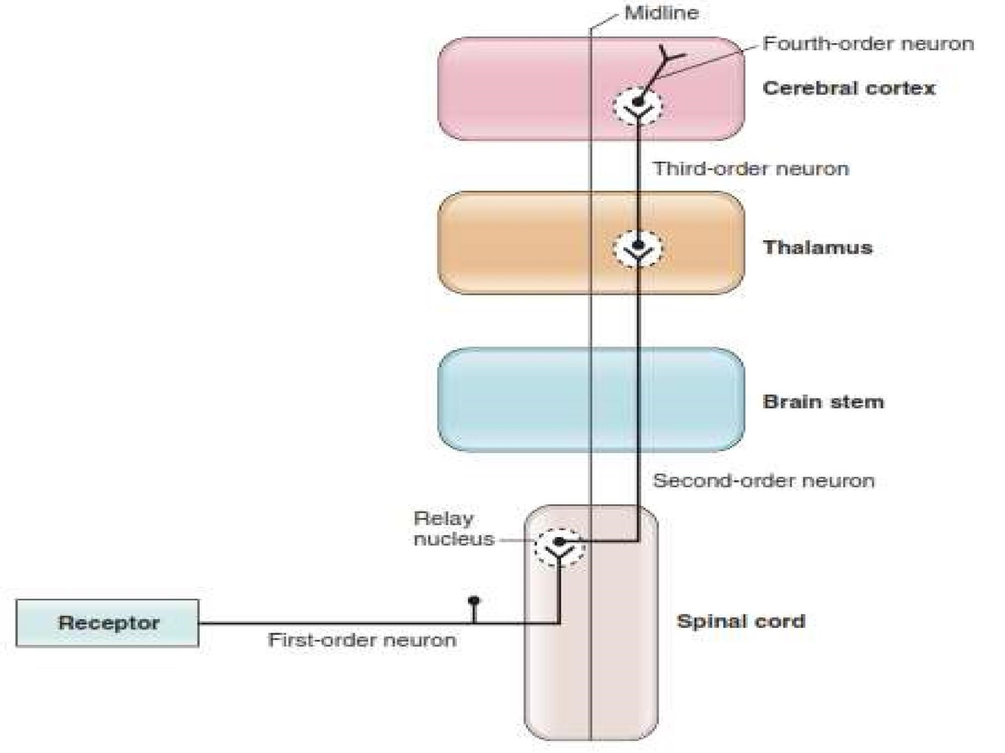

Slide 40
Processing

Slide 41
Processing Centers
The portion of CNS involved in the interpretation of the pain signals include the limbic system, reticular formation, thalamus, hypothalamus and cortex
Thalamus and sensitive cortex = perceives, describes and localizes pain.
Because the cortex, thalamus and brainstem are interconnected with the hypothalamus and autonomic nervous system, the perception of pain is associated with an autonomic response

Slide 42
Pain Modulation

Slide 43
Inhibition of Pain - Central Modulation 1 Inhibition of Pain
Pain may be inhibited or attenuated centrally via the following mechanisms
Gate theory: Stimulation of non-pain fibers peripherally inhibits WDR neurons.
Descending antinociceptive pathways:
– These neurons originate from periaquedutal gray areas
(other originate from the reticular formation and nucleus raphe magnus )

Slide 44
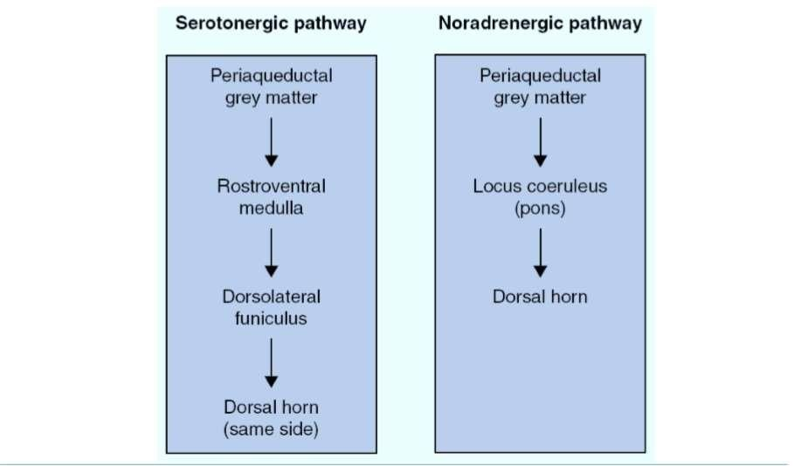
Descending Antinociceptive Pathways

Slide 45
Central Modulation 2 Enhancement of Pain
Pain may be enhanced centrally via the following mechanisms
Wind-up phenomenon: Persistence of action potential due to prolonged depolarization of the neuron despite the discontinuation of the stimulus
Spinal reflexes act as efferents back to the peripheral nociceptive field, which generate more nociceptive afferents

Slide 46
Peripheral Modulation
Primary hyperalgesia
Nociceptors are activated by excitatory amino acids (eg, glutamate) and neuropeptides (e.g. substance P).
The release of potassium, bradykinins, or prostaglandins from damaged tissues sensitizes nociceptors to create greater excitability and frequency of firing.
Secondary hyperalgesia
Mediated by substance P to the nociceptive field such that non-injured tissues are involved as well.

Slide 47
Mechanisms of Analgesia

Slide 48
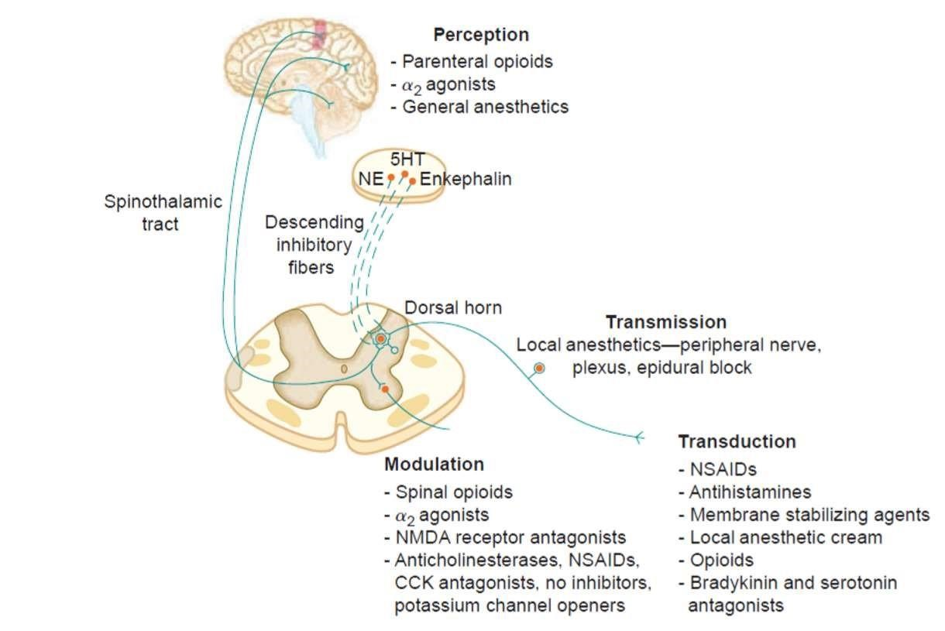

Slide 49
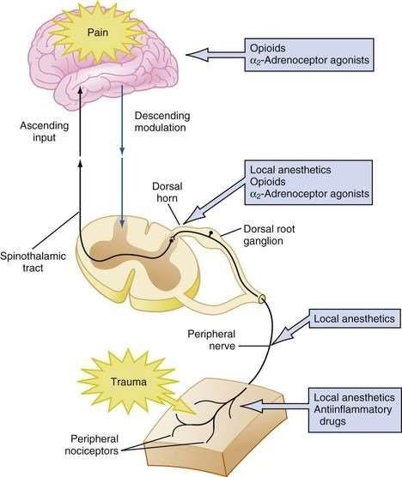

Slide 50
Ways of Blocking Pain Pathways / Analgesics
At site of injury ( decrease the pain associated with an inflammatory reaction) - e.g. non-steroidal anti-inflammatory drugs.
Alter nerve conduction (e.g. local anesthetics)
Modify transmission in the dorsal horn (e.g. opioids and some antidepressants)
Affect the central component and the emotional aspects of pain (e.g. opioids and antidepressants)
Others

Slide 51





Consequences
of Untreated
Pain

Slide 52
Endocrine / Metabolism
Increased release of vasopressin
RAAS activated (increased renin, angiotensin and aldosterone)
Increased cortisol, glucagon, growth hormone and catecholamine
Decreased insulin
Reduced testosterone
Result
Increased sympathetic output • Sodium and water retention
Increased protein catabolism
Increased blood sugar

Slide 53
Cardiovascular System
Hypertension, tachycardia and increased afterload / systemic vascular resistance
Result: Increased myocardial oxygen consumption
Increased risk of myocardial ischemic events
Decreased blood flow to viscera, kidneys and skin

Slide 54
Respiratory System
Abdominal or Thoracic PAIN
Diaphragm splinting , reduction in lung volumes and atelectasis
Hypoventilation
Hypoxemia
Weak cough and sputum retention.

Slide 55
Other Systems
Gastrointestinal System
Reduced gastric motility
Delayed gastric empting

Slide 56
Effects of Chronic Pain
Intermittent pain produces a physiologic response similar to acute pain.
Persistent pain allows for adaptation (functions of the body are normal but the pain is not relieved)
Behavioural and psychological changes to chronic pain
Depression
Sleeping disorders
Preoccupation with the pain
Tendency to deny pain

